Slide 1

Laptop Accessory Store
Afraz Haider 72935
Programming Fundamentals

Slide 2


CONTENTS
01: Admin panel
02: user panel

Slide 3
Introduction
My Project is a Laptop Accessory Store Management System in C++. It allows users to vieew and buy products, while admin can modify catalog, add or remove products and view the invoices.

Slide 4

Key Features
Admin Panel
(Password Protected)
User Panel
Easy to use interface

Slide 5
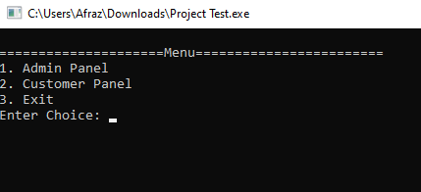
First Look

Slide 6
On the first Glimpse, We can see that the program shows:
We see the program ask which panel to use.
Either you choose the admin or the user panel.
we enter 1 for admin and 2 for user, and 3 to exit the program.

Slide 7
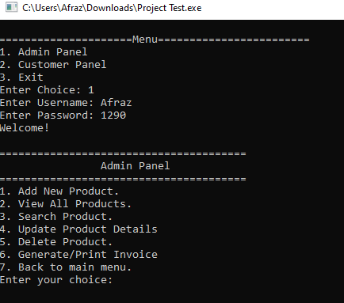
Admin Panel

Slide 8
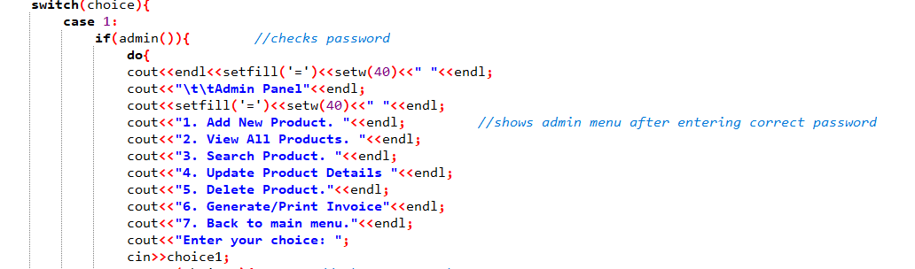

Slide 9

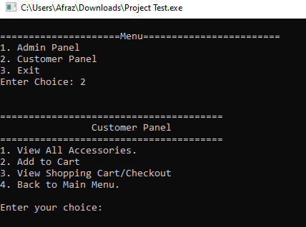
User Panel:

Slide 10
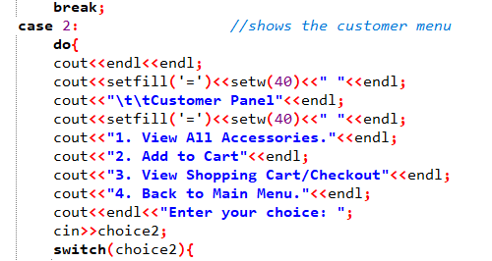

Slide 11

Summary of Key Features
Admin Panel
Admin can modify catalog and change values.
User Panel
Users can view catalog and buy items to checkout.

Slide 12
Thank You!
Any Questions?

